Slide 1
Unit 8:

Slide 2
Session 1
Objective: At the end of this lesson, students will be able to ask and answer questions in job interviews.

Slide 3
Activity 1: Who is faster?
Objectives:
Upon completion of this activity, students will be able to recall expressions for job interview.

Slide 4
Activity 1: Who is faster?
Instructions:
Work individually
Listen to questions often asked in job interviews from the teacher and give responses as quickly as possible
Other students listen and give comments

Slide 5
Sample:
T: How would you describe yourself? S: I’m a very organized person.

Slide 6
Activity 2: Completing an interview dialogue
Objectives:
Upon completion of this activity, students will be able to identify expressions for job interview.

Slide 7
Activity 2: Completing an interview dialogue
Instructions:
Work independently to complete the dialogue using statements from A to H
Compare answers with your partner
Check the answers with the whole class, then practice the dialogue in pairs.

Slide 8
Suggested answer
Interviewer: (1) (H) Now, why don’t you start by telling me about educational background?
Interviewee: (2) (E) I worked as a computer lab tutor at the university for about 2 years. Guiding students through their projects helped me get experience in several programming languages. My final school project was actually developing a mobile application, so I am fairly competent in developing mobile and web applications.
Interviewer: (3) (A) Why do you want to leave this job?
Interviewee: (4) (C) I am a diligent person and a fast learner. I am very eager to learn, and I get along fine with people.
Interviewee: (5) (G) I want to be working for your company in a leadership role.
Interviewee: (6) (B) Please tell me what is the goal of the company for the next 12 months?
Interviewee: (7) (D) That’s very interesting. Sir, when will I get to know the result of this interview?
Interviewee: (8) (F) No, I think I have a pretty good understanding of the job. I believe that I can handle it with ease, and I hope to have the opportunity to work for you. Thank you for your time, sir.

Slide 9
Activity 3: Role play
Objectives: Upon completion of this activity, students will be able to identify expressions for job interview.

Slide 10
Activity 3: Role play
Instructions
Work in pairs: Student A plays a role as an interviewer of Samsung, and student B as an interviewee who applies for a job in IT field.
Make a job interview role play by using given information on the card

Slide 11
A = interviewer | B = interviewee
1. Greet, introduce your name and position | 2. Respond to the interviewer’s greeting
3. Ask the candidate to introduce himself/herself | 4. Introduce yourself (for example: name, educational background and personalities,…)
5. Ask about his/her strength and weakness | 6. Strengths: work under high pressure, master low and high-level programming languages - Weaknesses: be afraid of speaking in front of public
7. Ask how he/she heard about the position | 8. Say that you read about it on careerlink.vn
9. Ask about his/her working experience | 10. Respond: Take a part time job as a junior programmer when you were fourth-year student. Work as a software developer in Y company since you graduated from university
11. Ask about what his/her job responsibilities in Y company | 12. Respond: Meet with customers to analyze their needs Develop software applications from the beginning to the end

Slide 12
A = interviewer | B = interviewee
13. Ask why she/he wants to leave that job | 14. Give reasons: Expect higher income to take better care of family Seek for more opportunities to work with foreign people and develop career
15. Ask about his/her salary expectation for this new position | 16. Respond: Salary expectation: be in line with technical skills and qualifications
17. Ask about his/her future plan in two coming years | 18. Respond: be a senior software developer
19. Ask if he/she has any questions | 20. Say ‘yes’ and ask about the short-term and long-term goal of the company
21. Respond: Short-term goal: launch a new software application next month Long-term goal: open another branch in Singapore | 22. Ask when you get the result of the interview
23. Respond: by the end of the month End the conversation | 24. Say thanks and goodbye

Slide 13
Suggested answer
A: Interviewer B: Interviewee
A: Good morning. I am (A), the Human Resources manager of ABC company. I’ll be interviewing you today. Can you introduce a little bit about yourself?
B: Sure. Nice to meet you. My name is (B). I graduated from Hanoi University of Industry with a degree in Software Engineering. I would describe myself as someone who is an organized person.
A: What is your greatest strength and weakness?
B: Well, I am skilled at working under high pressure and mastering low as well as high-level programming languages. But I’m afraid of speaking in front of public.
A: OK. Another question for you is that how you heard about this position?
B: To be honest, I read about it on careerlink.vn, a career website.
A: What about your working experience?

Slide 14
Suggested answer
A: Interviewer B: Interviewee
B: I took a part-time job as a junior programmer when I was the fourth-year students at HaUI. Besides, I have been working as a software developer in Y company since I graduated from university
A: What are your responsibilities in Y company?
B: I am in charge of meeting with customers to analyze their needs and developing software applications from start to finish that allow users to do specific tasks on a computer or another device.
A: Why do you want to leave that job?
B: I expect higher income to take better care of my family. Also, I want to seek for more opportunities to work with foreign people and develop my career.
A: What salary expectation would you like for this new position?
B: I hope that my salary is in line with my qualifications. I expect to be paid about 1,000 USD.

Slide 15
Suggested answer
A: Interviewer B: Interviewee
A: What are your future plans in two years? / Where do you see yourself being in two years from now?
B: Well, that’s a very hard question. ….hmmmm…. I’d love to be a senior software developer.
A: That’s good to hear. I think that’s enough for you. Do you have any questions for me?
B: Yes, I do. Could you tell me about the short-term and long-term goal of your company?
A: Good question. We are going to launch a new software application next month and our long term goal is to open another branch in Singapore.
B: So, when will I get the result of the interview?
A: Perhaps, by the end of this month.
B: Ok. Thank you for your time. Goodbye.
A: Thanks for coming. Bye.
Spacing mistake

Slide 16
Speaking card - activity 2 (role-play) – p84 – teacher’s handout

Slide 17
A = Interviewer | B = Interviewee
Greet, introduce your name and position Ask the candidate to introduce himself/herself | Respond to the interviewer’s greeting Introduce yourself: name, educational background and personalities
Ask how she/he heard about the position | Say that you read about it on a website
Ask why he/she wants to work for your company | Respond: You: have right skills, experience Company: offer overseas training opportunities, attractive salary => good chance to grow career
Ask about his/ her working experience | Respond: - 2014-2017: a junior technician for FPT soft - 2017-2021: a network supervisor at CMC Technology and Solutions Company
Ask about his/her job duties at CMC | Respond: - Mainly implement, manage and troubleshoot CMC’s network - Sometimes install, maintain and upgrade any software or hardware required to efficiently run a computer network

Slide 18
A = Interviewer | B = Interviewee
Ask why she/ he wants to leave the current job | Give reasons: - Travel on business too often - Look for better career prospects, professional growth
Ask about his/her future plans in the next 3 years | Respond: become a senior network systems administrator in his/ her company
Ask whether she/ he has any questions | Say ‘Yes’ and ask about the short-term goal of the company
Respond: - Open intensive training courses in IT for internal staff - Get chance to connect with foreign partners | Say that you wish to be a part of his/her company
Say to end the interview | Say thanks and goodbye

Slide 19
Suggested answer:
A: Good morning. I am …, Head of Human Resources of ABC company. I’ll be interviewing you today. Why don’t you start by introducing a little bit about yourself?
B: Sure. Nice to meet you. My name is …. I graduated from Hanoi University of Industry with a degree in Information Technology. I would describe myself as someone who is patient and creative.
A: That sounds good. How did you hear about this position?
B: Actually, I read about it on a website.
A: Why do you want to work here?
B: Firstly, I think that I have right skills and experience for this position. Secondly, your company offers attractive salary and overseas training opportunities So this is a good chance for me to grow my career.
A: Can you tell me about your working experience, please?
B: From 2014 to 2017, I worked as a junior technician for FPT soft. From 2017 and 2021, I have been working as a network supervisor at CMC Technology and Solutions company.

Slide 20
A: What are your duties at CMC?
B: I am mainly in charge of implementing, managing and troubleshooting CMC’s network. Sometimes, I have to install, maintain and upgrade software or hardware required to efficiently run a computer network.
A: Why do you want to leave that job?
B: I have to travel on business too often in my current job. Now, I’m looking for better career prospects and professional growth.
A: What are your future plans in the next three years?
B: Well, I’d love to be become a senior network systems administrator in your company.
A: That’s good to hear. Do you have any questions for me?
B: Yes, I do. Could you tell me about the short-term goal of your company?
A: Good question. We are going to open intensive training courses in IT for internal staff and make efforts to get chance to connect with foreign partners at the same time.
B: That sounds interesting. I wish to be a part of your company.
A: I think that’s enough for you. Thanks for coming. Bye.
B: Thank you for your time. Goodbye.

Slide 21
Session 2
Objectives:
At the end of the lesson, students will be able to conduct a mock job interview.

Slide 22
Activity 4: Tips for a successful job interview
Objective
Upon completion of this activity, students will be able to recognize important tips for a successful job interview

Slide 23
Activity 4: Tips for a successful job interview
Instructions
Work in groups
Read Top interview tips in the picture below, discuss and rank which tip is the most important for a successful job interview, and explain the reason(s)
Share your viewpoints with the class

Slide 24
Activity 4: Tips for a successful job interview
Instructions
Work in groups
Read Top interview tips in the picture below, discuss and rank which tip is the most important for a successful job interview, and explain the reason(s)
Share your viewpoints with the class

Slide 25
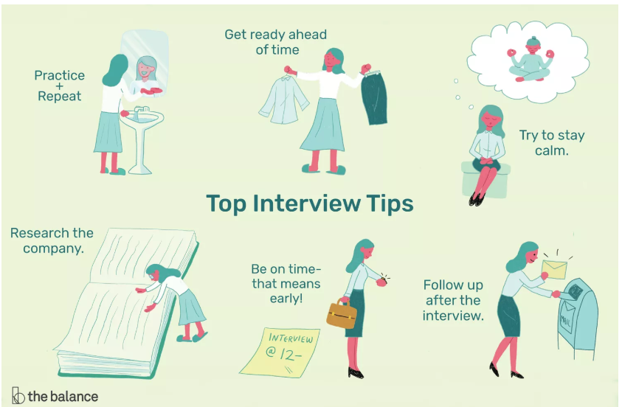
Activity 4: Tips for a successful job interview

Slide 26
Activity 5: Mock job interviews
Objective: Upon completion of this activity, students will be able to carry out a mock job interview based on given job recruitment news.

Slide 27
Activity 5: Mock job interviews
Instructions:
Choose ONE of four case studies on Job recruitment news to prepare a real CV and a cover letter at home
Work in pairs to carry out a mock job interview
Give comments based on criteria in the evaluation form below
Step 1: Preparation before class
At home, every student is required to prepare
a real CV
a cover letter
Step 2: In class
Bring CV, cover letter along
Take turns to make a mock job interview

Slide 28
Situation 1
Situation 2
Situation 3
Situation 4

Slide 29
Topic talk: Imagine you have taken part in a job interview recently. Retell it based on suggested questions
1. What position and company did you apply for?
2. Who interviewed you?
3. What questions were you asked?
4. What good/ bad things did you do?
5. What was the result of the interview?
6. What will you do to have a better job interview for the next time? / What advice can you give to have a successful interview?

Slide 30


